Slide 1
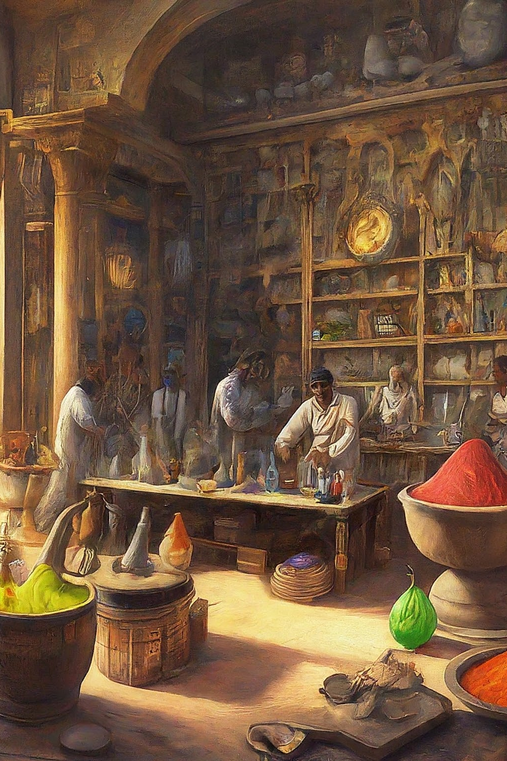
Introduction to Ancient Bharat
Ancient Bharat, known for its rich history and deep cultural heritage, was also home to significant advancements in the field of chemistry. The ancient scholars of Bharat, also known as India, made remarkable contributions to scientific knowledge, particularly in the realm of chemistry. This section will provide a comprehensive overview of ancient Bharat's scientific achievements, focusing specifically on the field of chemistry.

Slide 2
Overview of Ancient Bharat's scientific achievements
Alchemy
Astronomy
Medicine
Ancient Bharat's scholars were pioneers in the field of alchemy, exploring the transformation of substances and the quest for the mythical philosopher's stone.
The ancient Bharatiya scientists made significant strides in astronomy, developing mathematical models for planetary motion and star positions.
Bharat's contributions to the field of medicine were profound, with the development of Ayurveda and advancements in surgical techniques.

Slide 3

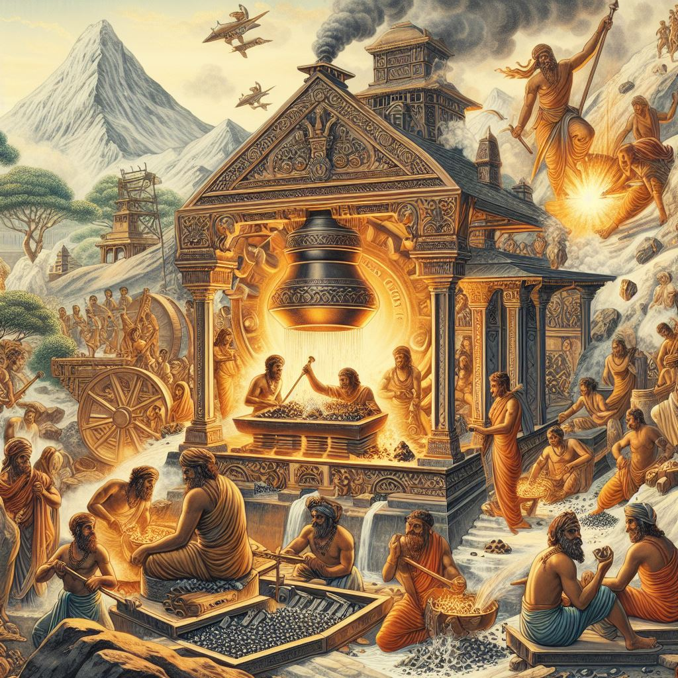
Ancient Bharat's contributions to metallurgy
1
Iron Extraction
Ancient Bharat was renowned for its advanced techniques in iron extraction from ores, contributing significantly to metallurgical knowledge.
2
Alloy Development
Ancient Bharatiya metallurgists excelled in the creation of alloys with specific properties, such as strength, malleability, and corrosion resistance.
3
Casting Techniques
The craftsmen of ancient Bharat mastered intricate casting methods for creating intricate metal artifacts and sculptures.

Slide 4
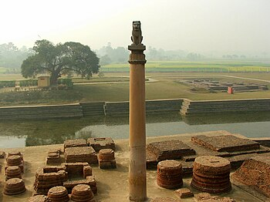
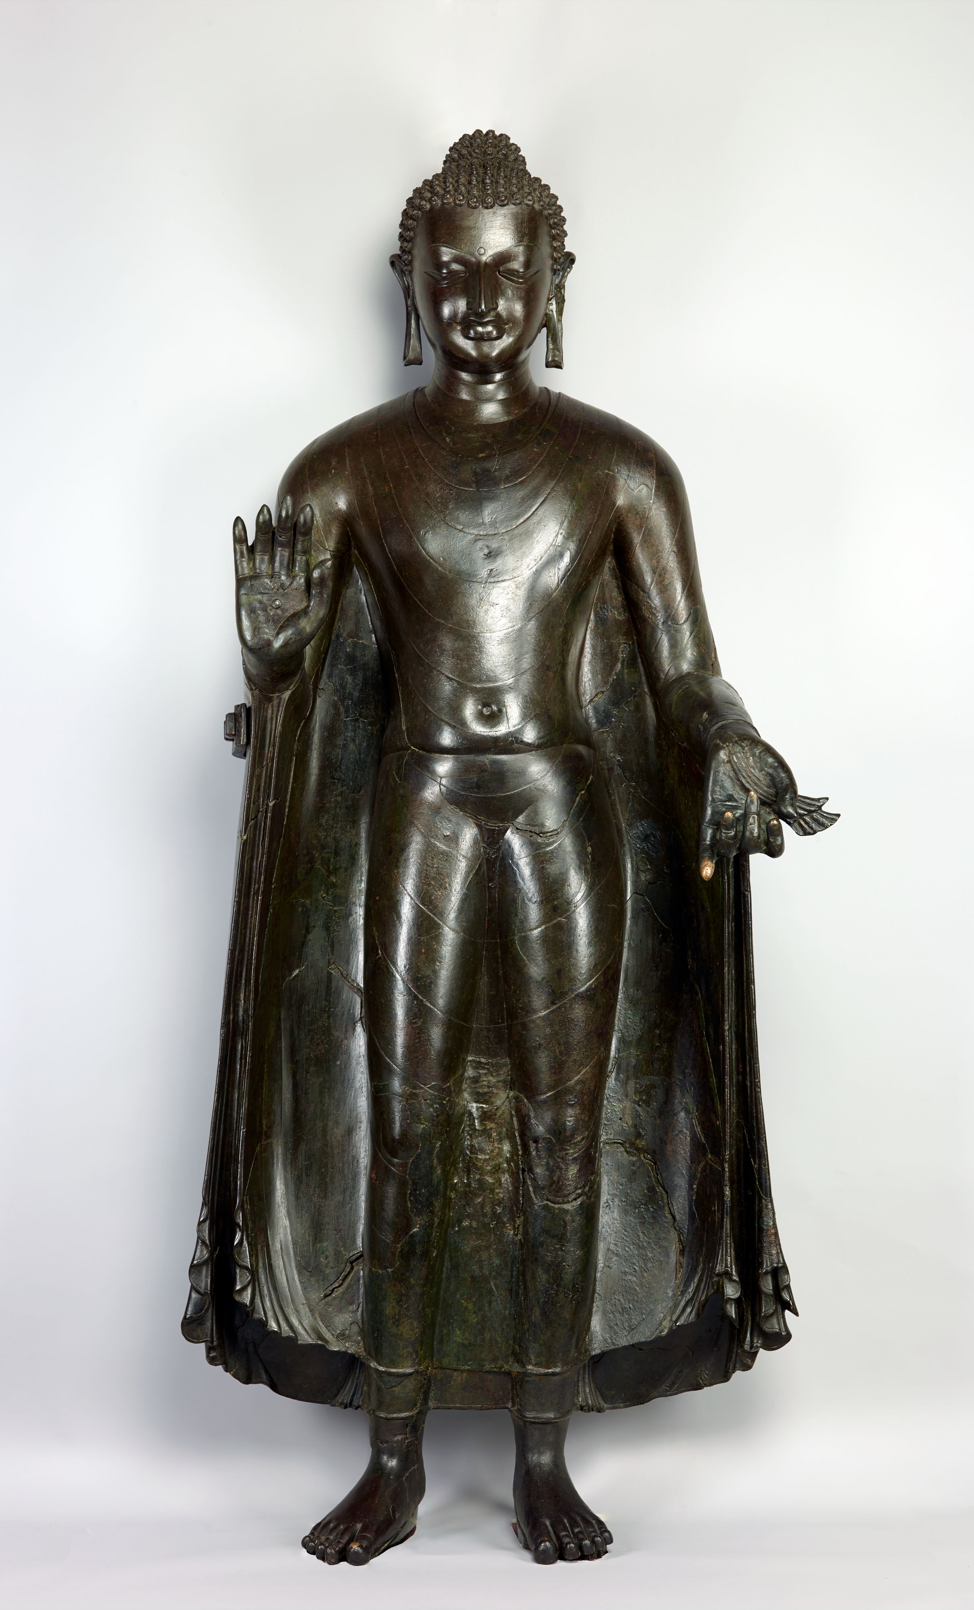
Metallurgical Contribution and Some Marvels Of Ancient Bharat
Ancient Bharat made significant contributions to metallurgy, particularly in iron extraction techniques. Advanced methods of iron smelting, documented in texts like the Arthashastra and Sangam literature, showcase the sophistication of ancient Indian metallurgical knowledge. Excavations at sites such as Rakhigarhi and Kodumanal provide archaeological evidence of widespread iron production, highlighting Bharat's pivotal role in the advancement of metallurgical practices in antiquity.
Iron Pillar of Delhi: Build in 4th century CE, this impressive wrought iron pillar stands over 7 meters tall and weighs over 6 tons. Remarkably, it has remained rust-free for over 1,600 years, demonstrating the advanced metallurgical expertise of ancient Indian craftsmen.
The Sultanganj Buddha is a large copper statue of Lord Buddha dating back to the 7th century CE. It is renowned for its exquisite craftsmanship and the use of advanced bronze casting techniques.

Slide 5
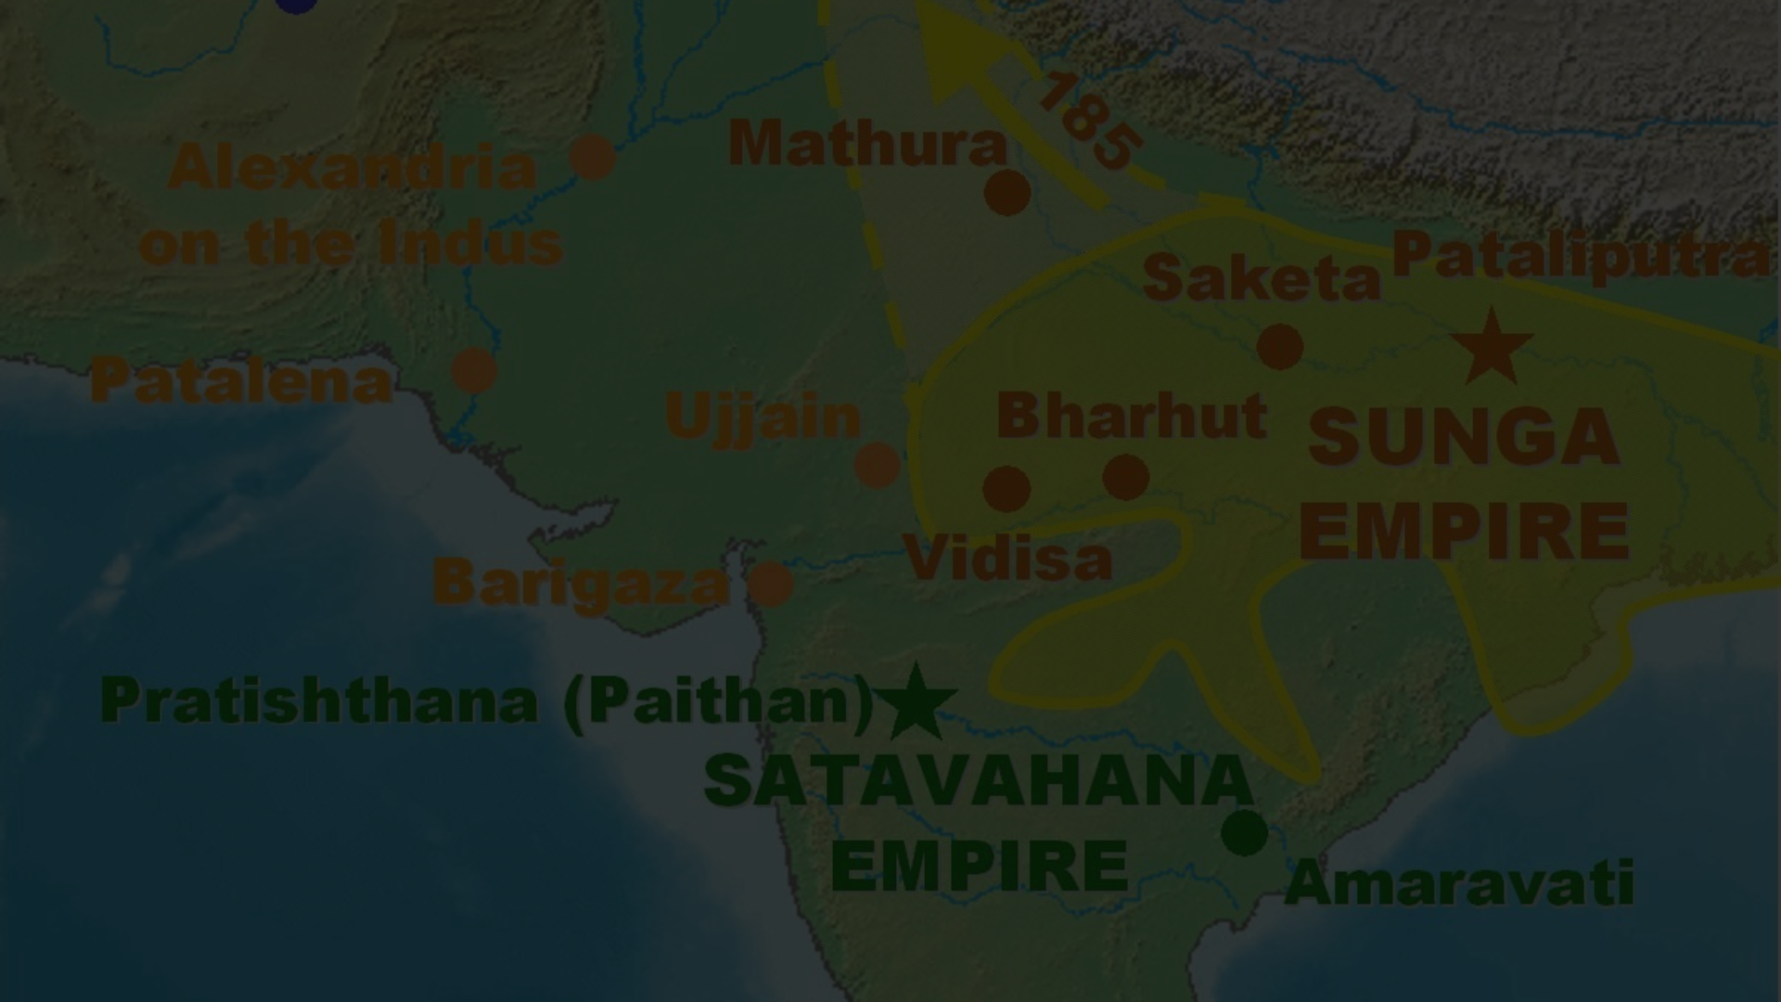
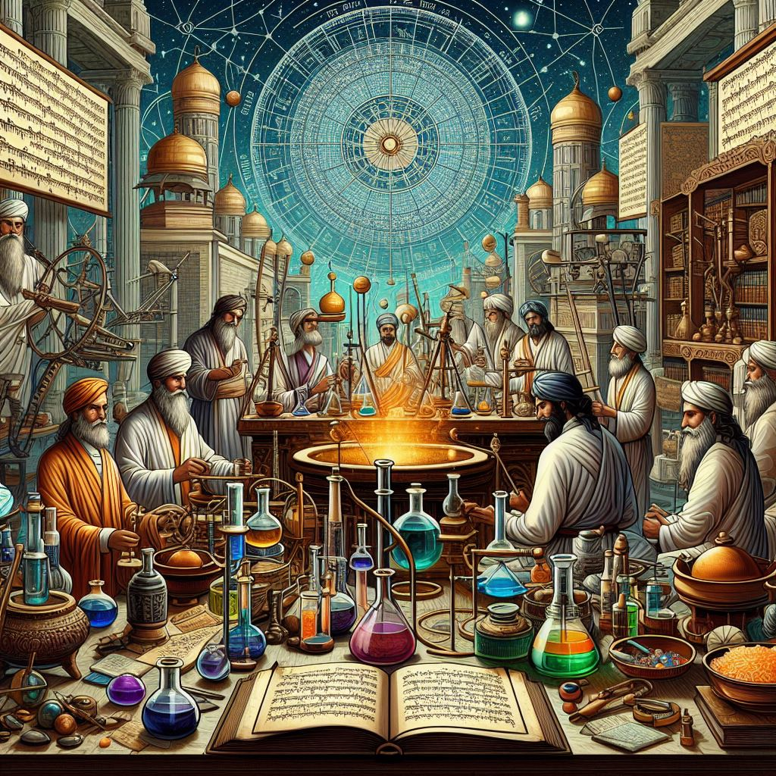
The discovery and use of chemicals in Ancient Bharat
Herbal Extracts
Ancient Bharat utilized a wide variety of herbal extracts for medicinal, spiritual, and ritualistic purposes.
Preservation Techniques
Ancient Bharatiya scholars developed innovative methods for food preservation using natural chemicals and processes.
Aromatic Compounds
The discovery and use of aromatic compounds for perfumes, incense, and therapeutic applications were prevalent in ancient Bharat.

Slide 6
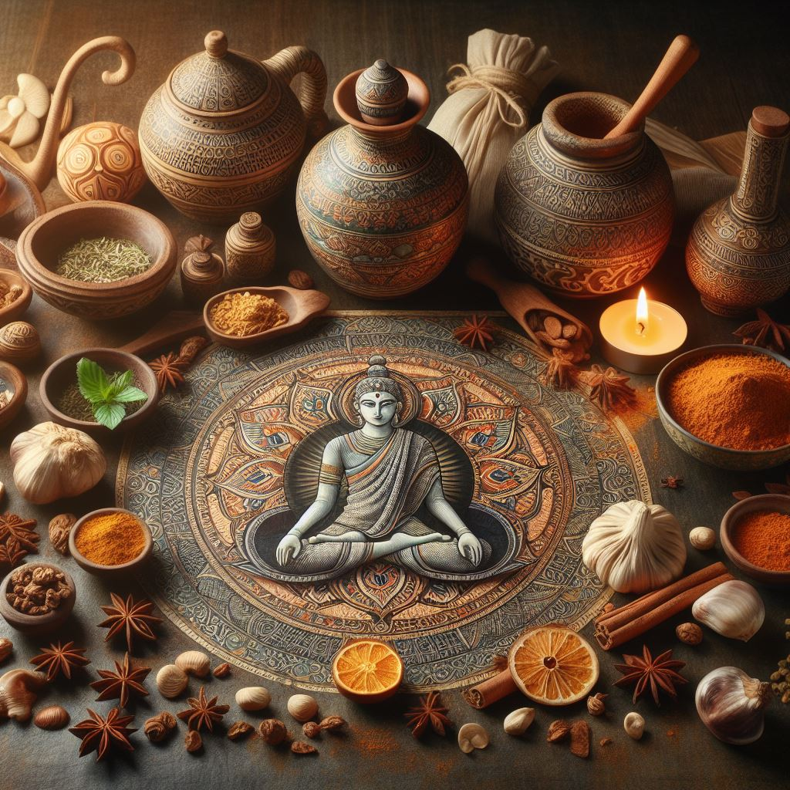
The importance of Ayurveda in Ancient Bharat’s Chemistry
Foundations of Ayurveda:
Ayurveda, ancient Bharat's traditional system of medicine, heavily relied on principles of chemistry. The understanding of chemical processes, including the properties of various substances and their interactions, formed the basis of Ayurvedic pharmacology and formulations for treating illnesses and maintaining health.
Herbal Alchemy:
Ayurveda utilized herbal remedies extensively, incorporating botanical extracts and formulations derived through alchemical processes. These processes involved techniques such as distillation, fermentation, and extraction, aimed at isolating active compounds from medicinal plants.
Metal-Based Medicines:
Ayurveda also embraced the use of metal-based medicines known as "Rasa Shastra." This branch of Ayurveda involved the purification and processing of metals and minerals to create therapeutic formulations. Knowledge of metallurgy and chemistry was essential for preparing these medicines, which were believed to have potent healing properties when used correctly..

Slide 7
Key figures in Ancient Bharat's chemistry
Nagarjuna (931AD)
Renowned ancient physician and herbalist, credited with the authorship of the foundational Ayurvedic text, the Charaka Samhita.
Revered alchemist and metallurgist, known for his alchemical treatises and the development of the methodology of distillation.

Slide 8
Conclusion and future implications
In conclusion, the contributions of ancient Bharat to the field of chemistry are profound and far-reaching. The knowledge and advancements made by Bharatiya scholars have significantly shaped the trajectory of scientific thought and practice, both in antiquity and in the present day. Understanding the depth and breadth of ancient Bharat's chemical knowledge provides valuable insights for current and future scientific advancements.

